Slide 1
Compound Interest

Slide 2
Compound Interest

Slide 3
Simon has invested $50,000 for 6 years with Star Bank. The interest rate is 4% pa, compounded annually.
What would the investment at the end of one year, two years, three years, six years respectively?
What is the percentage increase on Simon’s original investment at the end of year 6?
What is the total interest at the end of year 6?
What if the bank paid simple interest? What would be the amount of the interest in this case after year 6?
Is Simon better off with compound or simple interest?
What can you conclude? Can you think of a formula to use to calculate compound interest?

Slide 4
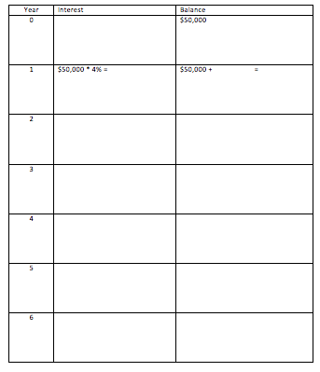



Slide 5













Slide 6
Compound Interest - annual
A = P*(1 + R)^{n}
Where
A = final amount
P = principal
R = rate (%) pa
n = number of years

Slide 7
Example – loan (compound interest)
Cathy borrowed $40,000 from the bank to start her own business. The interest rate is 6% compounded annually. Cathy will pay the whole loan back at the end of the loan period which is 4 years.
How much would Cathy owe the bank after 2 years?
What is the total amount Cathy has to pay back the bank?
What is the total interest paid by Cathy?
How much would Cathy have to pay the bank if the bank were 6% simple interest?

Slide 8
Compound Interest – periods other than annual
A = P*(1 + R)^{n}
Where
A = final amount
P = principal
R = rate (%)
n = number of compounding periods

Slide 9
Consider the following
If $12,000 is invested at 8% per annum interest rate, with interest compounded annually, what is the investment worth after 12 years?
What if the interest is compounded every 6 months? What is the investment after 12 years?
What if the interest is compounded every 3 months? What is the investment after 12 years?

Slide 10
